Slide 1

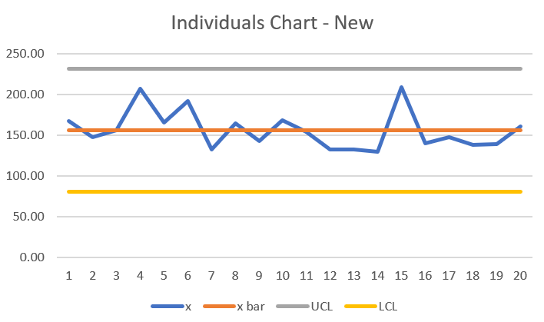
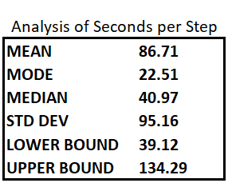
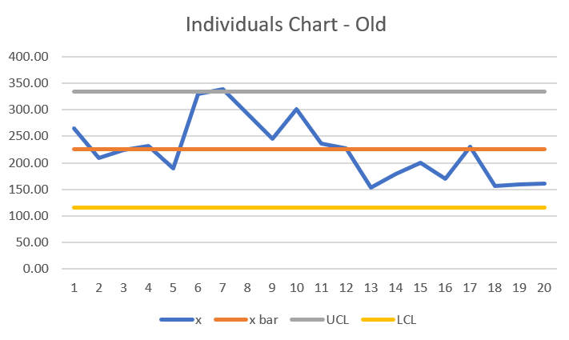
Reduce Submission Time of Data Review Requests
Process Owner: Michael Morales
Project Launch 07/18/2018
Measure 08/02 and 08/13/2018
Analyze 8-13-2018
Improve 8-30-2018
Control - Continuing
Define
Measure
Analyze
Improve
Problem Statement
Analyzing the details report for cost and usage bucketing errors and/or inconsistencies, and correcting the errors, is a long process that needs to be standardized for efficiency and training.
Improvement opportunities observed:
Screenshots being saved to desktop when copy and paste were an option. Better app available.
Documentation too detailed – rules of correspondence etiquette being used when boilerplate would suffice
Other potential areas of improvement were not within our control.
Submission of Data Review Request takes up most of the time
With a mean time of 3.75 minutes, the DRR submission step takes 63% of the mean total time of 5.96 minutes.
The DRR process is out of control
43.26
Mean seconds per screenshot – old process
16.22
Mean seconds per screenshot – new process
Control
Business Impact
This process is the responsibility of interns and outsourced support staff, but training and follow-up fall to permanent staff. This results in an average hourly cost estimate of $25. Reducing the time will reduce the cost.
DRRs are the defects!
Defect reduction can be maintained in that new snipping software has been installed and standardized documentation has been approved.
DPMO 125k
SQL=2.65
54.21
Average Seconds
Old documentation process
12.63
Average Seconds
New documentation process

Slide 2
DPMO and SQL
DPMO 125k
SQL=2.65
DPMO was calculated by taking the 10 DRRs that were above the average for that metric as defects out of the 80 total opportunities
DPMO of 125,000 gives us a process sigma value of 2.65

Slide 3
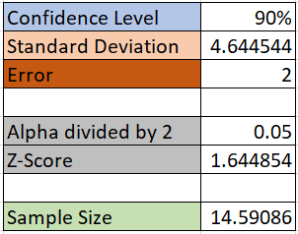
Sample Size Calculation
Analyze Report | Analyze Invoice | Analyze Other Invoices | DRR | Totals (sec) | Totals (min)
44.26 | 20.14 | 74.29 | 264.31 | 808 | 13.47
22.51 | 5.28 | 41.39 | 209.32 | 561 | 9.35
19.31 | 25.08 | 2.19 | 223.6 | 546.36 | 9.11
12.92 | 96.84 | 78.2 | 231.53 | 846.98 | 14.12
22.51 | 131.01 | 40.54 | 189.57 | 777.26 | 12.95
38.44 | 23.05 | 23.7 | 330.2 | 842.78 | 14.05
5.03 | 61.01 | 161.35 | 338.08 | 1144.94 | 19.08
53.03 | 63.94 | 1 | 291.78 | 835.5 | 13.93
51.52 | 16.88 | 17.12 | 244.86 | 678.76 | 11.31
80.77 | 18.91 | 307.64 | 300.95 | 1436.54 | 23.94
73.82 | 56.79 | 124.73 | 236.33 | 1006.34 | 16.77
15.02 | 16.99 | 53.38 | 227.57 | 650.92 | 10.85
8.37 | 9.12 | 13.45 | 152.7 | 394.28 | 6.57
23.7 | 10.04 | 5.38 | 179.55 | 466.34 | 7.77
17.61 | 36.97 | 24.6 | 200.11 | 589.58 | 9.83
36.86 | 11.4 | 5.84 | 170.29 | 481.78 | 8.03
94.29 | 64.55 | 82.19 | 230.57 | 978.2 | 16.30
8.4 | 9.15 | 13.43 | 157.11 | 413.18 | 6.89
8.42 | 9.17 | 13.41 | 159.54 | 420.08 | 7.00
8.39 | 9.21 | 13.46 | 160.48 | 424.08 | 7.07
Sample size was calculated using total minutes.

Slide 4
Raw Data and Collection Method
Collection Methods
Data were collected by first observing the process, then breaking it down into steps.
Using two stopwatches alternately, each step was timed as accurately as possible.
The goal was simply to measure the length of time of the process while focusing on what we could control.
 | CASS Client? | Total Seconds | Analyze Report | Analyze Invoice | Analyze Other Invoices | DRR
1 | 0 | 404 | 44.26 | 20.14 | 74.29 | 264.31
2 | 0 | 280.5 | 22.51 | 5.28 | 41.39 | 209.32
3 | 0 | 273.18 | 19.31 | 25.08 | 2.19 | 223.6
4 | 0 | 423.49 | 12.92 | 96.84 | 78.2 | 231.53
5 | 0 | 388.63 | 22.51 | 131.01 | 40.54 | 189.57
6 | 0 | 421.39 | 38.44 | 23.05 | 23.7 | 330.2
7 | 0 | 572.47 | 5.03 | 61.01 | 161.35 | 338.08
8 | 0 | 417.75 | 53.03 | 63.94 | 1 | 291.78
9 | 0 | 339.38 | 51.52 | 16.88 | 17.12 | 244.86
10 | 0 | 718.27 | 80.77 | 18.91 | 307.64 | 300.95
11 | 1 | 502.67 | 73.82 | 56.79 | 124.73 | 236.33
12 | 1 | 324.96 | 15.02 | 16.99 | 53.38 | 227.57
13 | 1 | 196.64 | 8.37 | 9.12 | 13.45 | 152.7
14 | 1 | 232.67 | 23.7 | 10.04 | 5.38 | 179.55
15 | 1 | 294.29 | 17.61 | 36.97 | 24.6 | 200.11
16 | 1 | 240.39 | 36.86 | 11.4 | 5.84 | 170.29
17 | 1 | 488.6 | 94.29 | 64.55 | 82.19 | 230.57
18 | 1 | 206.09 | 8.4 | 9.15 | 13.43 | 157.11
19 | 1 | 209.54 | 8.42 | 9.17 | 13.41 | 159.54
20 | 1 | 211.54 | 8.39 | 9.21 | 13.46 | 160.48
Means |  | 357.32 | 32.26 | 34.78 | 54.86 | 224.92
Means in minutes |  | 5.96 | 0.54 | 0.58 | 0.91 | 3.75
Outlier here
And here

Slide 5
Measurement Definitions
Analyze Report
Analyze Invoice
Analyze Other Invoices
Submit DRR
Analyzing the report did not include logging in, opening the customer-facing web portal, choosing a client, and downloading the report. Since these factors cannot be controlled by the intern performing the analysis and there are not multiple methods for completing them, they were not considered valuable metrics for the purposes of this study. Only in instances where errors were found were the measurements taken. This was determined by whether or not the intern went on to analyze invoice data.
Analyzing the invoice included clicking the link to an invoice checklist, opening the link for the invoice image, and then comparing and/or contrasting the invoice values against the data in the details report. A times this involved summing numbers on a calculator. In every sample collected, the intern went on to also analyze other invoice data, but at times this involved nothing more than to see if other invoices were available.
Analyzing other invoices varied widely as a result of the needs of the situation. This portion of the measurement sometimes only required a review of whether other invoices had posted to the portal, and at other times required a careful analysis of invoice values to ensure correct “bucketing” of values in the report, comparison of invoices values to report values by bucket, and/or calculating total invoice values to ensure consistency with report values.
The measurement titled DRR (Data Review Request) was the longest and most involved step of the process. As such, it could be broken down into steps and measured as the subject of a separate study on its own. Some of it is not in the scope of control of the intern, though much of it (in terms of time) is. This step began once an error was identified and analyzed for how to correct it (part of the invoice analysis step). It ended when all the pertinent information had been entered into a service help desk ticket form and submitted successfully. This involves selecting from several drop-down menus, entering a detailed description, attaching a screenshot, and entering invoices ID numbers. The 2 controllable steps in the process were taking and attaching the screenshot, and providing a detailed description of the problem.

Slide 6
Over the UCL here
And also here
Used Excel to calculate mR and mRbar, allowing for calculation of upper and lower control limits. The process is out of control.
Also used Excel to calculate x and x bar, allowing for calculation of upper and lower control limits. The process is out of control here as well.

Slide 7
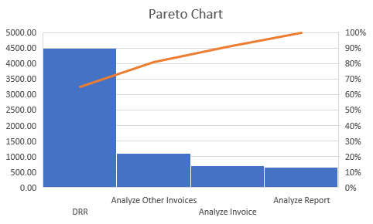
Measures of Center
The elapsed seconds graph gives us a visual that supports the findings in the Pareto chart below.
The vital few are identified in the Pareto chart. The majority of our problems come from one step in the process.
Close observation of the DRR portion of the process revealed that there were two possible inefficiencies:
Screenshots were taken with the inefficient native app and being saved to the desktop instead of copied and pasted
Documentation was unique each time, even on repeat errors, and formal rules of correspondence etiquette being employed

Slide 8
Improvements
Screenshots could be pasted from the clipboard, but were being saved to the desktop and then found by browsing Windows Explorer. Also, the native Snipping Tool app was being employed, when third-party app SnagIt was available. SnagIt offers one-button functionality and faster, easier options for editing screen captures.
43.26
Mean seconds per screenshot – old process
16.22
Mean seconds per screenshot – new process
Documentation was entered into the submission form using formal rules of etiquette. All examples identified the error, followed with “if you could please look into (error) and correct it I would greatly appreciate it.” Documentation was also being re-entered repeatedly even though errors generally fall into a small number of categories. The 5 most common errors (per the intern) were given standardized documentation saved to a Word document for copying/pasting.
54.21
Average Seconds
Old documentation process
12.63
Average Seconds
New documentation process

Slide 9
Regressions
Before Improvements
After Improvements
Regression Statistics
Multiple R | 0.8998
R Square | 0.8096
Adjusted R Square | 0.7416
Standard Error | 0.2608
Observations | 20
ANOVA
 | df | SS | MS | F | Significance F
Regression | 5 | 4.0479 | 0.8096 | 11.9044 | 0.0001230
Residual | 14 | 0.9521 | 0.0680
Total | 19 | 5.0000
 | Coefficients | Standard Error | t Stat | P-value
Intercept | 0.4740 | 0.4220 | 1.1233 | 0.2802
Total Seconds | 0.0594 | 0.0132 | 4.5145 | 0.0005
Analyze Report | -0.0583 | 0.0140 | -4.1711 | 0.0009
Analyze Invoice | -0.0601 | 0.0128 | -4.7155 | 0.0003
Analyze Other Inv | -0.0595 | 0.0133 | -4.4646 | 0.0005
DRR | -0.0621 | 0.0123 | -5.0302 | 0.0002
Regression Statistics
Multiple R | 1
R Square | 1
Adjusted R Square | 1
Standard Error | 2.50E-14
Observations | 20
ANOVA
 | df | SS | MS | F | Significance F
Regression | 4 | 171868.36 | 42967.09 | 6.89E+31 | 2.80E-234
Residual | 15 | 9.35E-27 | 6.23E-28
Total | 19 | 171868.36
 | Coefficients | Standard Error | t Stat | P-value
Intercept | 2.84E-14 | 8.57E-14 | 3.32E-01 | 7.45E-01
Analyze Report | 1 | 2.55E-16 | 3.92E+15 | 1.68E-226
Analyze Invoice | 1 | 1.73E-16 | 5.77E+15 | 5.17E-229
Analyze Other Inv | 1 | 1.12E-16 | 8.89E+15 | 7.78E-232
DRR - NEW | 1 | 5.53E-16 | 1.81E+15 | 1.86E-221

Slide 10
After improvements, the process is now under control

Slide 11
New DPMO and SQL
DPMO 87.5k
SQL=2.86
New DPMO was calculated by taking the 7 DRRs that were above the average for that metric as defects out of the 80 total opportunities
New DPMO of 87,500 gives us a new process sigma value of 2.86

Slide 12

With new screenshot software, a new process for attaching the screenshot to the DRR submission form, and standardized documentation, the new process can be controlled by training new interns to use these efficiencies.

